Slide 1



Drivers and distribution of global ocean heat uptake over the last half century
Maurice F. Huguenin^{1,2}, Ryan M. Holmes^{1,3,4} and Matthew H. England^{1,2}
¹Climate Change Research Centre and Australian Research Council Centre of Excellence for Climate Extremes, University of New South Wales
²Australian Centre of Excellence in Antarctic Science, University of New South Wales
³School of Mathematics and Statistics, University of New South Wales
⁴School of Geosciences, University of Sydney, Sydney
Notes:
Nuccitelli et al., 2012. Comment on “Ocean heat content and Earthʼs radiation imbalance. II. Relation to climate shifts”

Slide 2
Importance of ocean heat content
Notes:
Nuccitelli et al., 2012. Comment on “Ocean heat content and Earthʼs radiation imbalance. II. Relation to climate shifts”

Slide 3
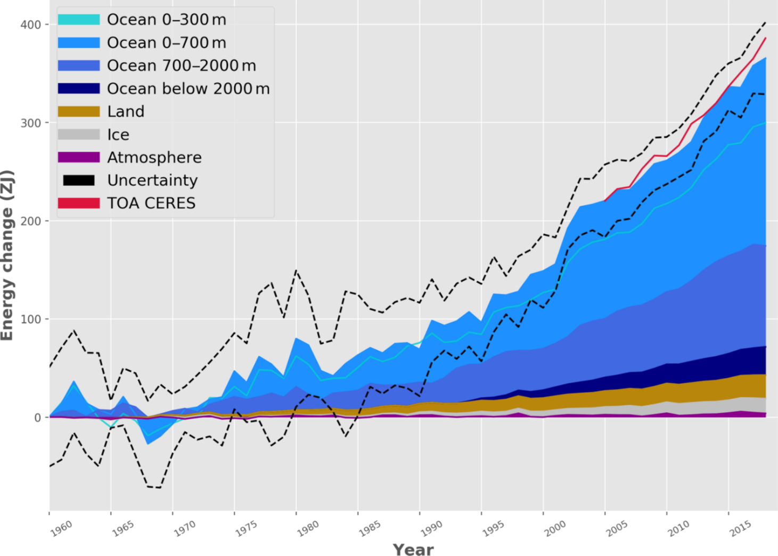


Importance of ocean heat content
Earth heat inventory relative to 1960 (ZJ = 10²¹ J)
von Schuckmann et al. (2020)
Where has heat entered the ocean?
Where is it today?
What are the roles of wind and thermal forcing?
Notes:
Nuccitelli et al., 2012. Comment on “Ocean heat content and Earthʼs radiation imbalance. II. Relation to climate shifts”

Slide 4
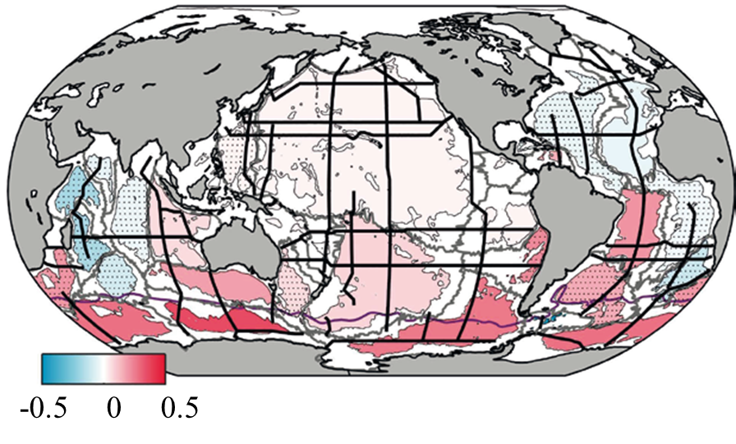
Importance of ocean heat content
Earth heat inventory relative to 1960 (ZJ = 10²¹ J)
Warming rate (°C century⁻¹) below 4000 m
von Schuckmann et al. (2020)
IPCC SROCC, Ch. 5, Fig. 5.4b, Allison et al. (2019)
Where has heat entered the ocean?
Where is it today?
What are the roles of wind and thermal forcing?
Notes:
Nuccitelli et al., 2012. Comment on “Ocean heat content and Earthʼs radiation imbalance. II. Relation to climate shifts”

Slide 5
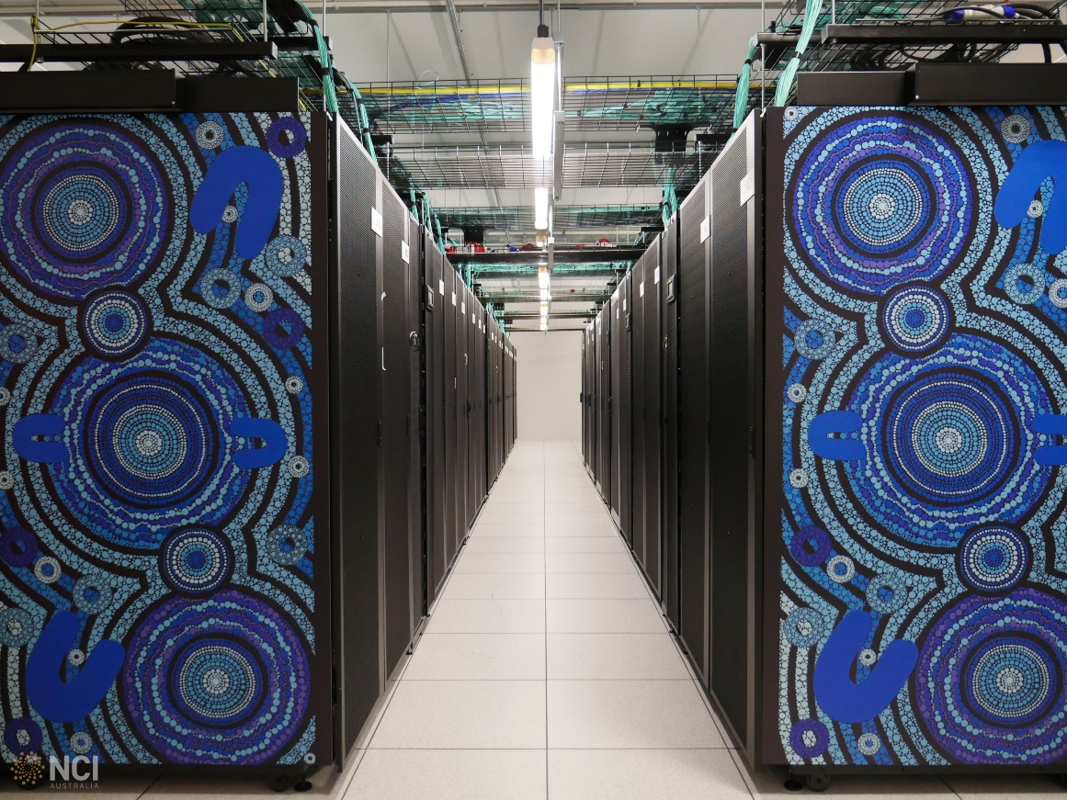
Global ocean-sea ice model
ACCESS-OM2 (Kiss et al., 2019)
YATM, CICE5.1, MOM5.1
1° horizontal resolution
50 z* vertical levels
input: atm. reanalysis JRA55-do (Tsujino et al., 2018)
nci.org.au
Notes:
EOF patterns and associated principle components of equatorial wind stress anomalies from the Era-Interim Reanalysis product
these are the figures I had in my proposal, it turned out they were incorrect
I created them anew (see next slide) but they are not 100% what I expect

Slide 6
New spin-up for ocean-sea ice models
Notes:
EOF patterns and associated principle components of equatorial wind stress anomalies from the Era-Interim Reanalysis product
these are the figures I had in my proposal, it turned out they were incorrect
I created them anew (see next slide) but they are not 100% what I expect

Slide 7
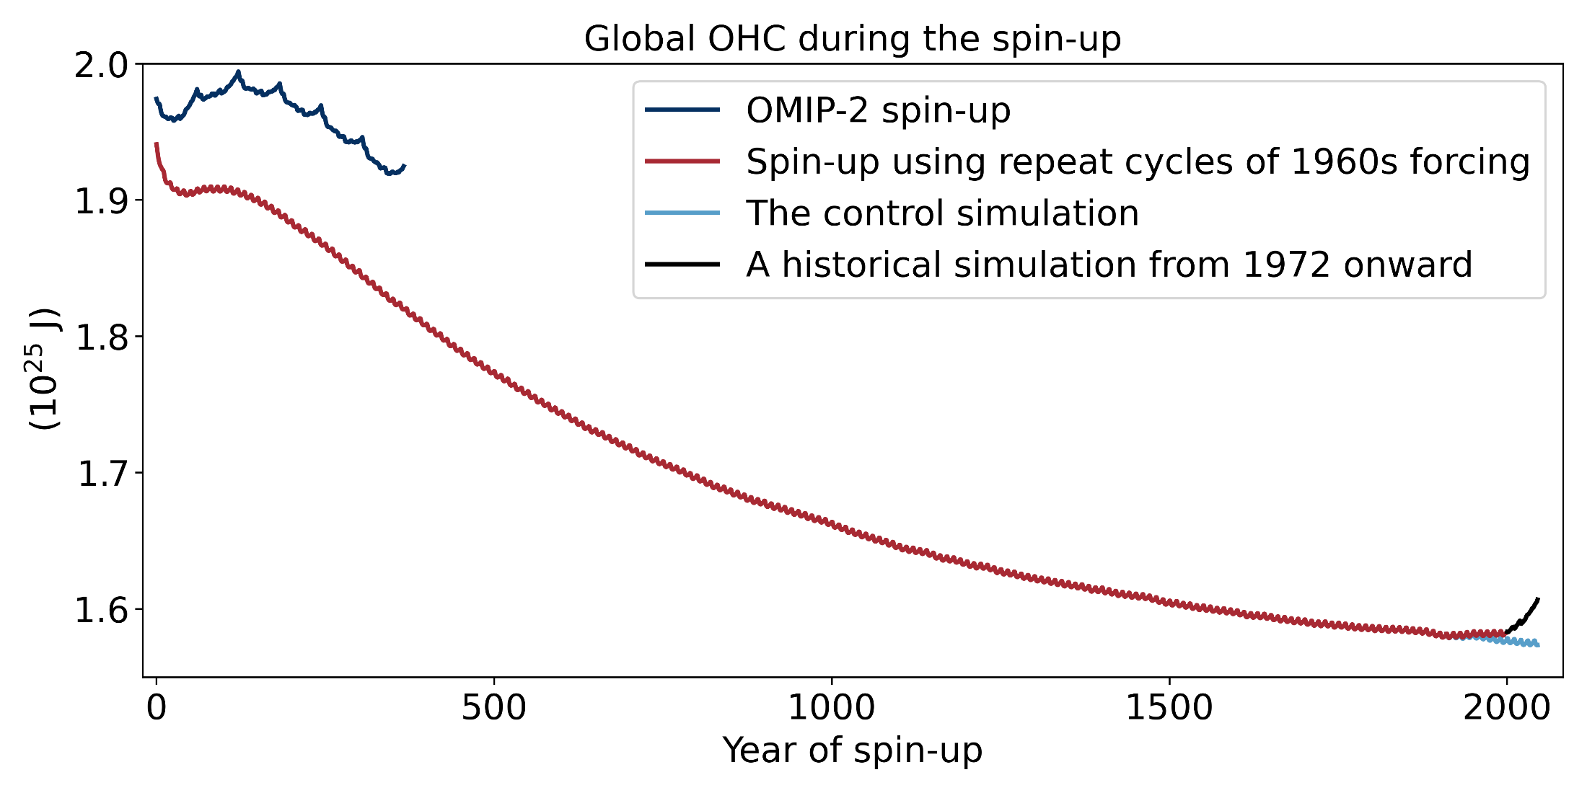
New spin-up for ocean-sea ice models
Notes:
EOF patterns and associated principle components of equatorial wind stress anomalies from the Era-Interim Reanalysis product
these are the figures I had in my proposal, it turned out they were incorrect
I created them anew (see next slide) but they are not 100% what I expect

Slide 8
New spin-up for ocean-sea ice models
Notes:
EOF patterns and associated principle components of equatorial wind stress anomalies from the Era-Interim Reanalysis product
these are the figures I had in my proposal, it turned out they were incorrect
I created them anew (see next slide) but they are not 100% what I expect

Slide 9
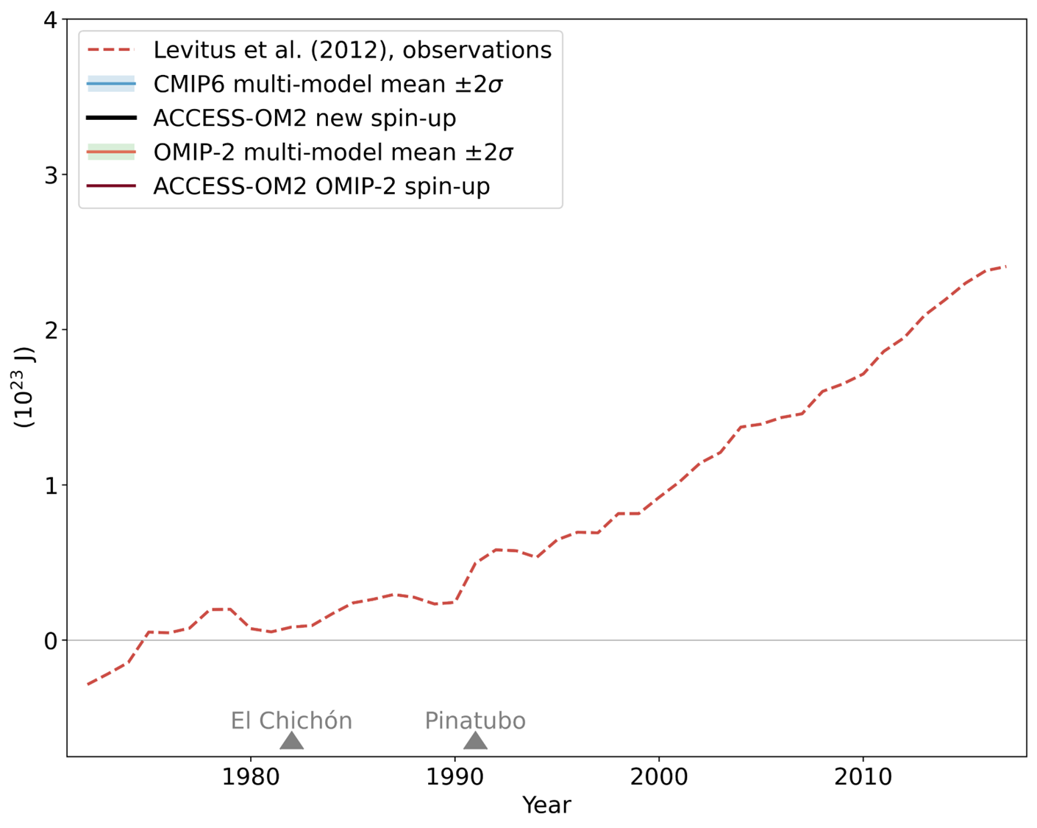
Global ocean heat content anomalies 0-2000 m
Notes:
EOF patterns and associated principle components of equatorial wind stress anomalies from the Era-Interim Reanalysis product
these are the figures I had in my proposal, it turned out they were incorrect
I created them anew (see next slide) but they are not 100% what I expect

Slide 10
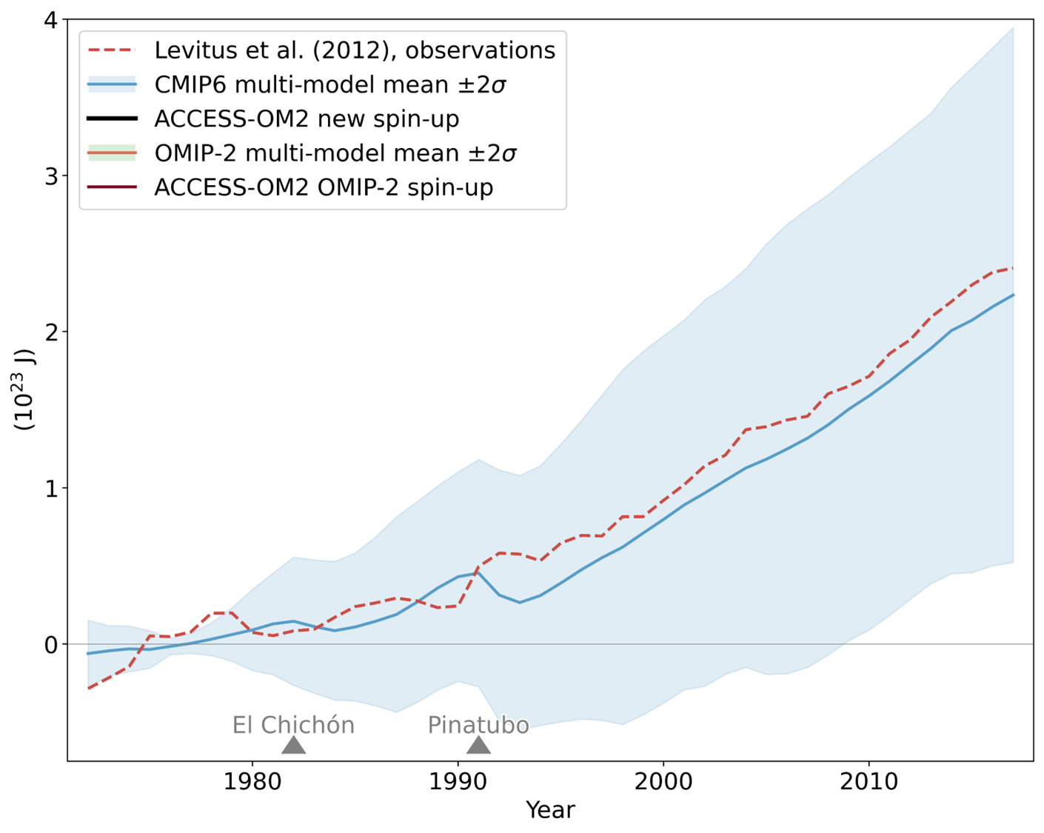

Global ocean heat content anomalies 0-2000 m
Notes:
EOF patterns and associated principle components of equatorial wind stress anomalies from the Era-Interim Reanalysis product
these are the figures I had in my proposal, it turned out they were incorrect
I created them anew (see next slide) but they are not 100% what I expect

Slide 11
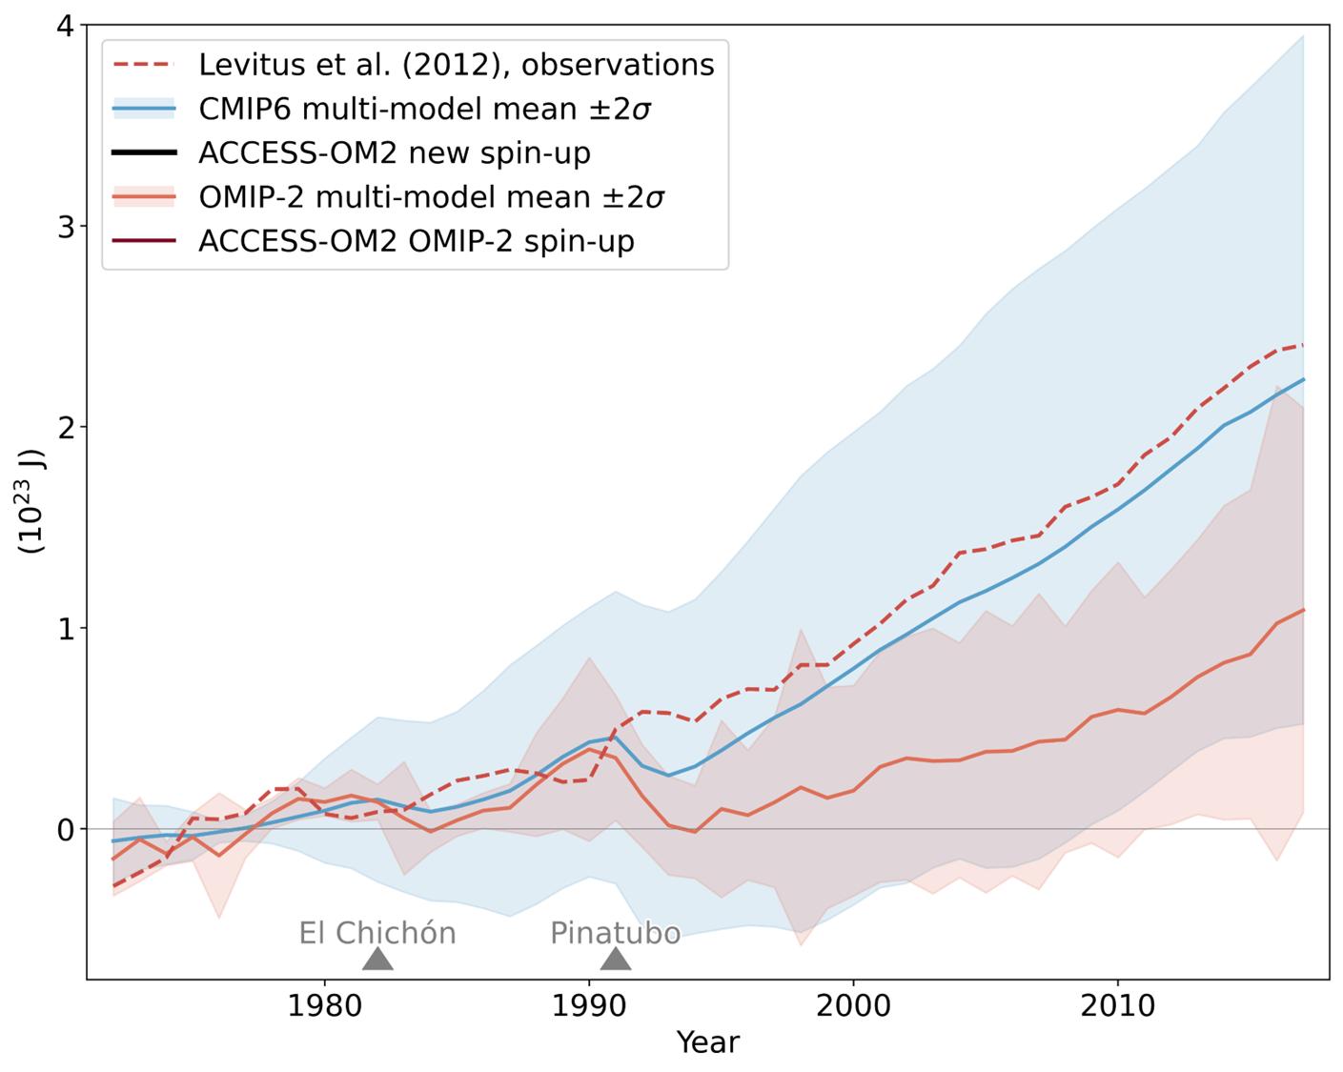
Global ocean heat content anomalies 0-2000 m
Notes:
EOF patterns and associated principle components of equatorial wind stress anomalies from the Era-Interim Reanalysis product
these are the figures I had in my proposal, it turned out they were incorrect
I created them anew (see next slide) but they are not 100% what I expect

Slide 12
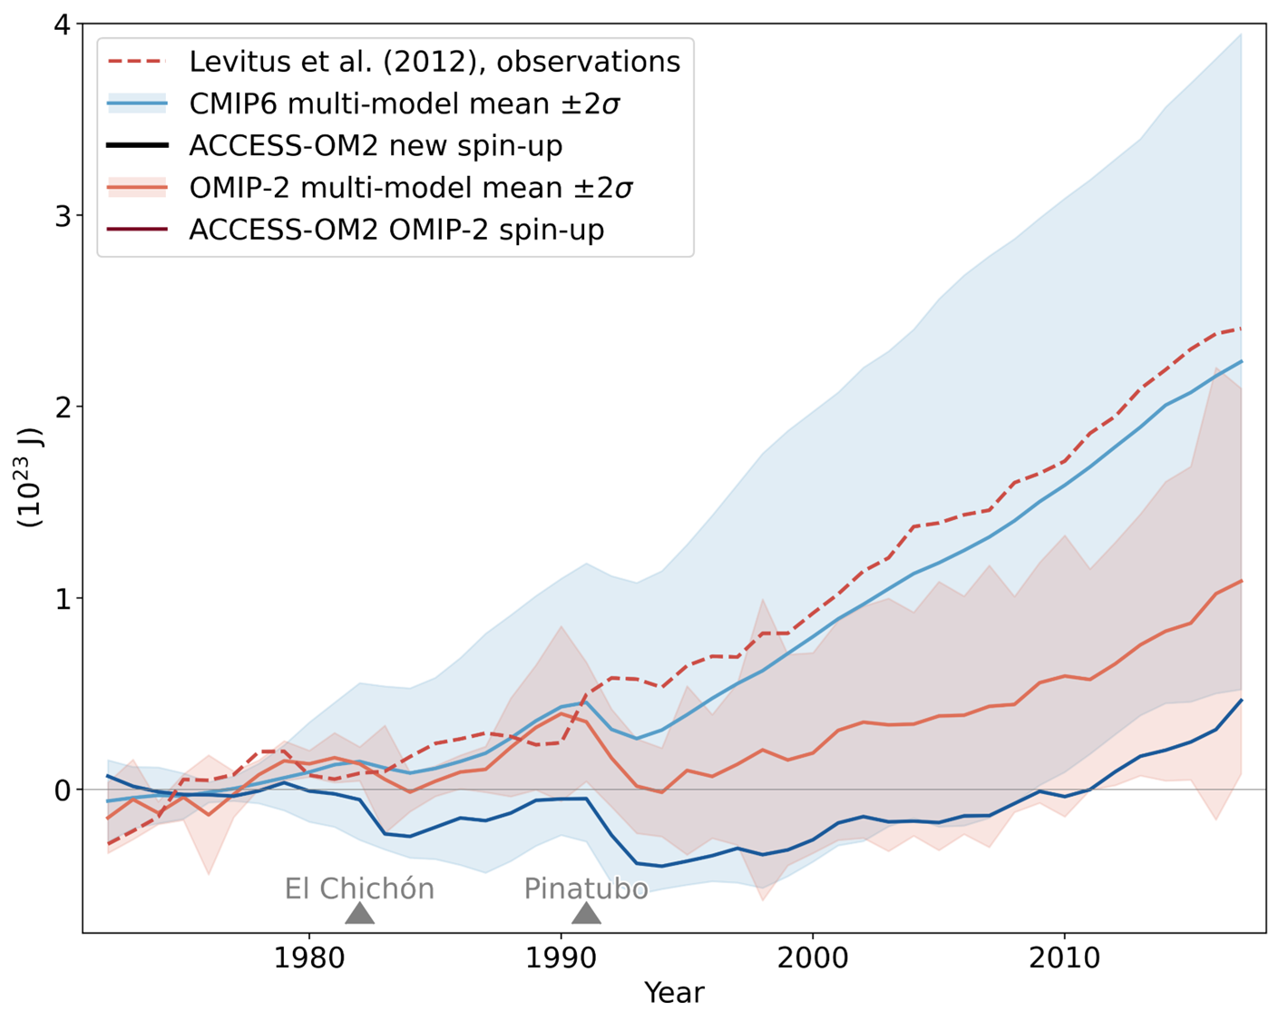
Global ocean heat content anomalies 0-2000 m
OLD
Notes:
EOF patterns and associated principle components of equatorial wind stress anomalies from the Era-Interim Reanalysis product
these are the figures I had in my proposal, it turned out they were incorrect
I created them anew (see next slide) but they are not 100% what I expect

Slide 13
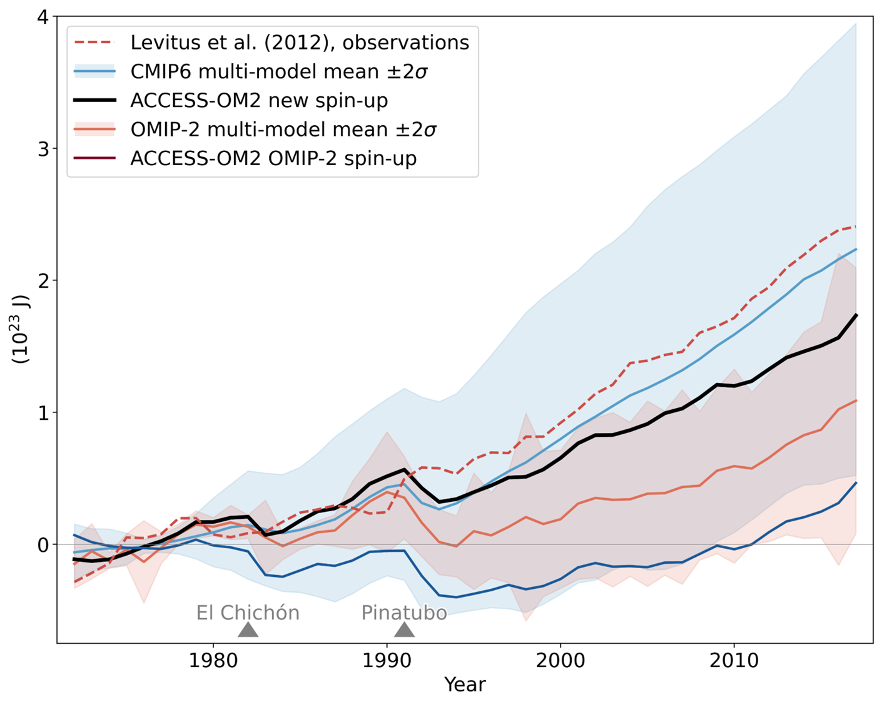
Global ocean heat content anomalies 0-2000 m
NEW
OLD
Notes:
EOF patterns and associated principle components of equatorial wind stress anomalies from the Era-Interim Reanalysis product
these are the figures I had in my proposal, it turned out they were incorrect
I created them anew (see next slide) but they are not 100% what I expect

Slide 14
Role of surface wind and thermal forcing
Notes:
Nuccitelli et al., 2012. Comment on “Ocean heat content and Earthʼs radiation imbalance. II. Relation to climate shifts”

Slide 15
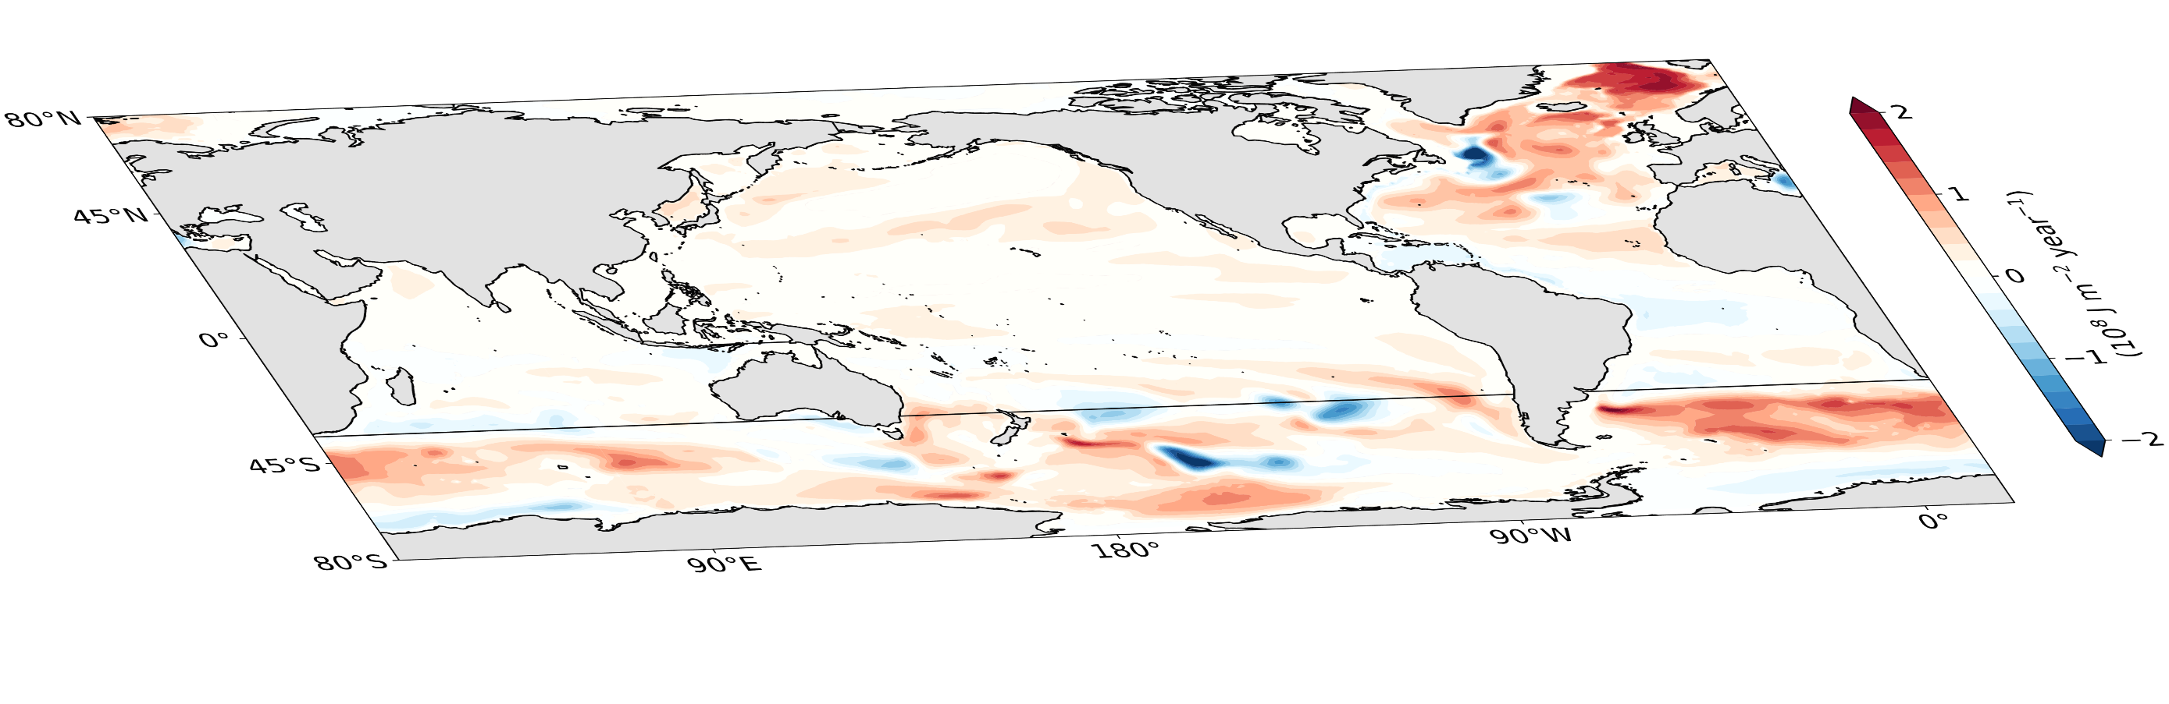
Role of surface wind and thermal forcing
Notes:
Nuccitelli et al., 2012. Comment on “Ocean heat content and Earthʼs radiation imbalance. II. Relation to climate shifts”

Slide 16
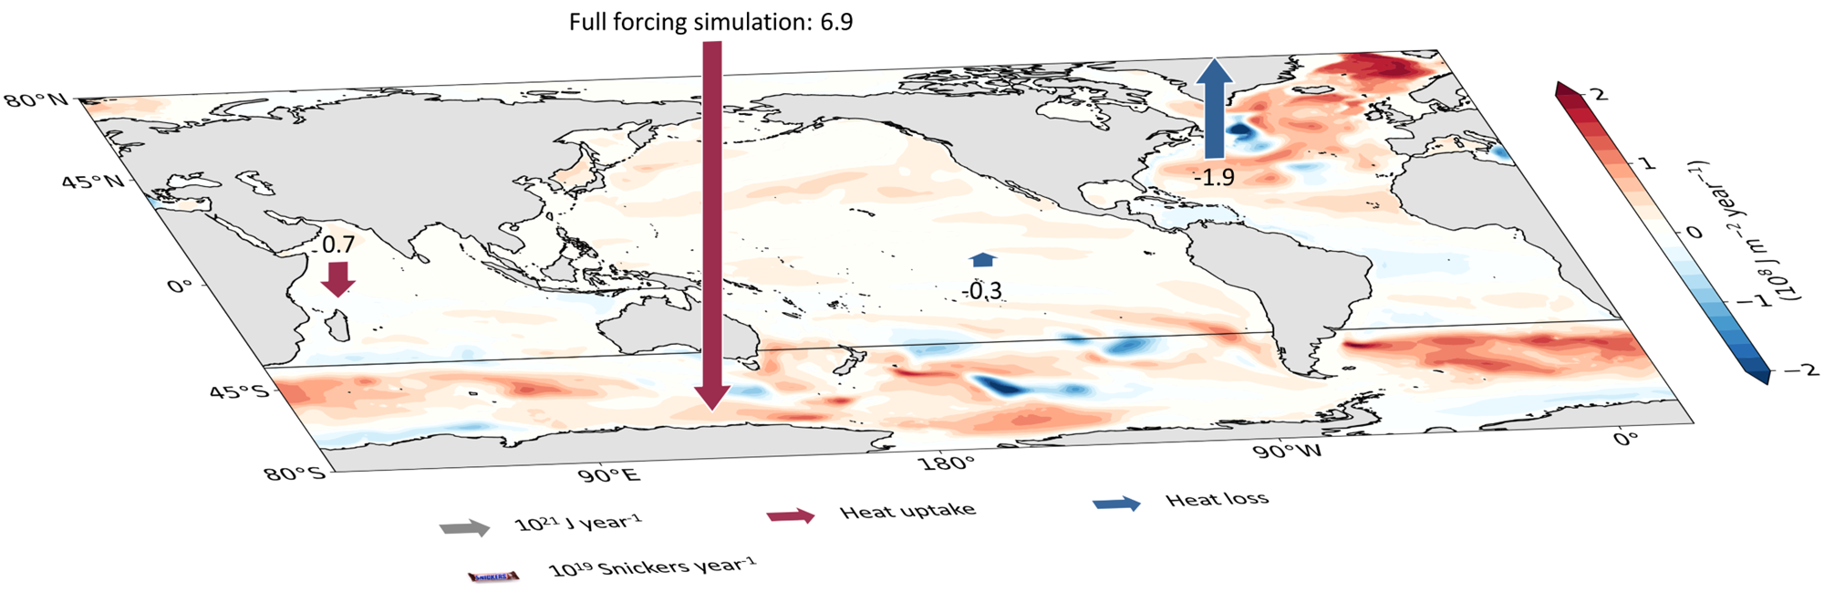
Role of surface wind and thermal forcing
1 Snickers = 250 cal ≙ 1046 J
Notes:
Nuccitelli et al., 2012. Comment on “Ocean heat content and Earthʼs radiation imbalance. II. Relation to climate shifts”

Slide 17
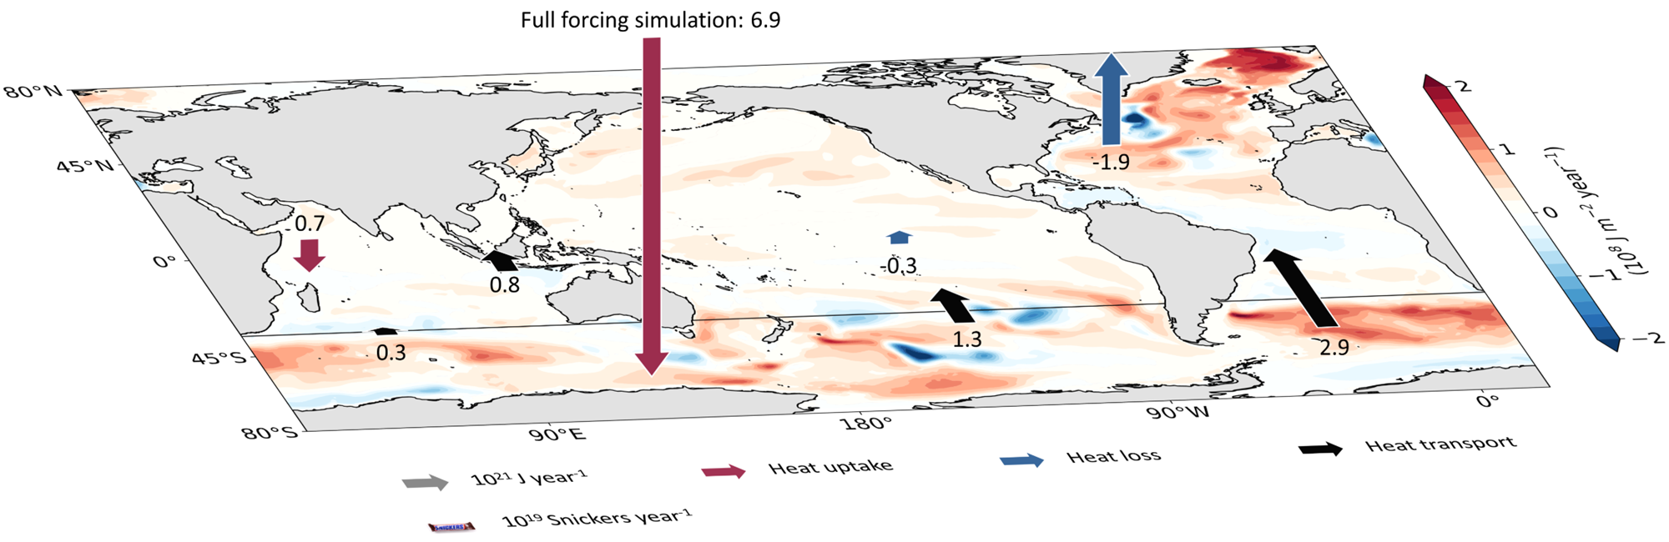
Role of surface wind and thermal forcing
1 Snickers = 250 cal ≙ 1046 J
Notes:
Nuccitelli et al., 2012. Comment on “Ocean heat content and Earthʼs radiation imbalance. II. Relation to climate shifts”

Slide 18
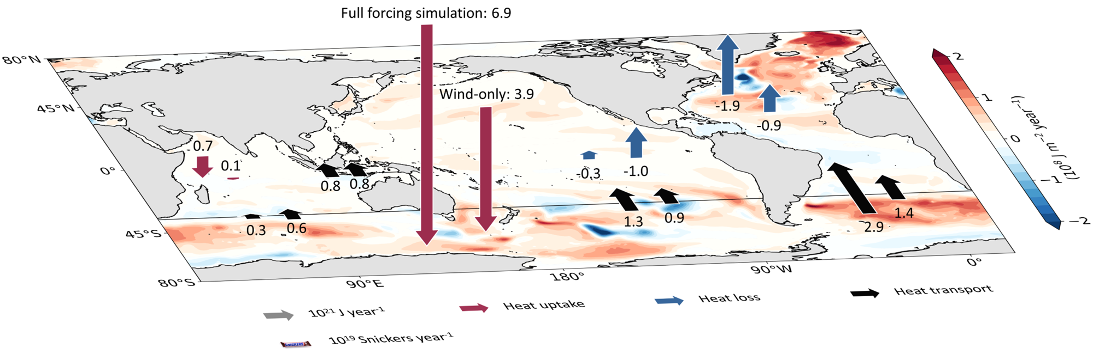
Role of surface wind and thermal forcing
1 Snickers = 250 cal ≙ 1046 J
Notes:
Nuccitelli et al., 2012. Comment on “Ocean heat content and Earthʼs radiation imbalance. II. Relation to climate shifts”

Slide 19
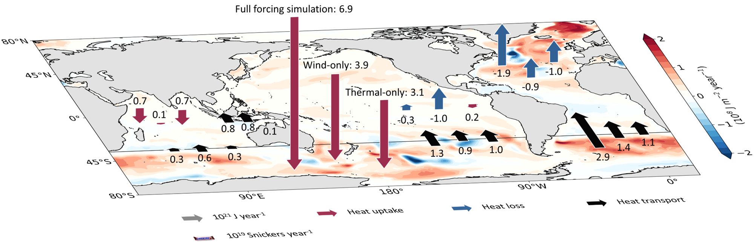
Role of surface wind and thermal forcing
1 Snickers = 250 cal ≙ 1046 J
Notes:
Nuccitelli et al., 2012. Comment on “Ocean heat content and Earthʼs radiation imbalance. II. Relation to climate shifts”

Slide 20

Huguenin et al. (2022), in review Nat. Comm.
New repeat decade spin-up → better OHC evolution than most OMIP-2 models
Recent surface wind and thermal property trends: ~50% of global ocean warming → almost 100% with only Southern Ocean trends
This heat uptake facilitated by cool SSTs & significant sensible heat fluxes when thermal forcing is held fixed; downward longwave radiation more dominant when winds are fixed & thermal properties evolve over time.
EGU conference
m.huguenin-virchaux@unsw.edu.au

Slide 21
Huguenin et al. (2022), in review Nat. Comm.
Repeat decade spin-up → better OHC evolution than most OMIP-2 models
Recent surface wind and thermal property trends: ~50% of global OHC → almost 100% with only Southern Ocean trends
Heat uptake facilitated by cool SSTs & dominant …
… sensible heat fluxes with thermal forcing held fixed
… downward longwave radiation when winds are fixed & thermal properties evolve over time
EGU conference
m.huguenin-virchaux@unsw.edu.au

Slide 22
Huguenin et al. (2022), in review Nat. Comm.
Repeat decade spin-up → better OHC evolution than most OMIP-2 models
Recent surface wind and thermal property trends: ~50% of global OHC → almost 100% when applied only over Southern Ocean
Heat uptake facilitated by cool SSTs & dominant …
… sensible heat fluxes with thermal forcing held fixed
… downward longwave radiation when winds are fixed & thermal properties evolve over time
EGU conference
m.huguenin-virchaux@unsw.edu.au

Slide 23
Huguenin et al. (2022), in review Nat. Comm.
Repeat decade spin-up → better OHC evolution than most OMIP-2 models
Recent surface wind and thermal property trends: ~50% of global OHC → almost 100% when applied only over Southern Ocean
Heat uptake facilitated by cool SSTs & dominant …
… sensible heat fluxes with thermal forcing held fixed
… downward longwave radiation when winds are fixed & thermal properties evolve over time
EGU conference
m.huguenin-virchaux@unsw.edu.au

Slide 24
7:00.00 min

Slide 25
Additional slides

Slide 26
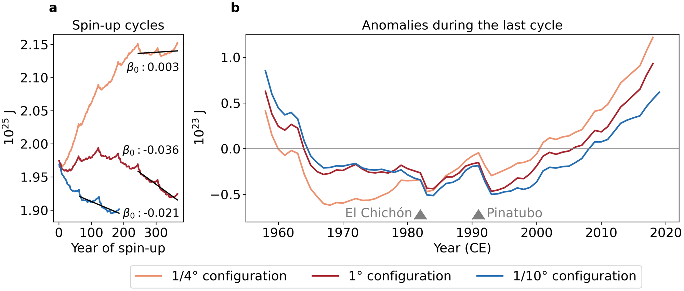
Spin-up so far
Notes:
EOF patterns and associated principle components of equatorial wind stress anomalies from the Era-Interim Reanalysis product
these are the figures I had in my proposal, it turned out they were incorrect
I created them anew (see next slide) but they are not 100% what I expect

